Slide 1
Linear Regression of California Airbnb Data
D214: Capstone
Shawn Wheeler
000364855

Slide 2
About Me
- My name is Shawn Wheeler
- 37 years old
- I’m a student in the MSDA program
- I have a background most recently in database administration and CRM development and support
- Looking for a career shift into a more data-centric role

Slide 3
Research Question
- Within the California Aribnb data set, to what extent do the independent variables ‘accommodates,’ ‘beds,’ ‘bathrooms_text,’ ‘bedrooms,’ ‘amenities,’ ‘room_type,’ and ‘city’ affect the dependent variable ‘price?’

Slide 4
Hypotheses
Null Hypothesis: The independent variables ‘accommodates,’ ‘beds,’ ‘bathrooms_text,’ ‘bedrooms,’ ‘amenities,’ ‘room_type,’ and ‘city’ do not affect the dependent variable ‘price in a statistically significant way based on an alpha value of 0.05.
Alternative Hypothesis: The independent variables ‘accommodates,’ ‘beds,’ ‘bathrooms_text,’ ‘bedrooms,’ ‘amenities,’ ‘room_type,’ and ‘city’ affect the dependent variable ‘price’ in a statistically significant way based on an alpha value of 0.05.

Slide 5
Data Analysis Process
- Data Collection and Extraction: Data was sourced from Kaggle and is a compilation of Airbnb data over the course of 3 months.
- Exploratory Data Analysis
- Data Cleaning: Data was checked and corrected for duplicates, outliers, missing data, and any other aberrations.
- Data Preparation: Data was converted to numerical values, variables were broken down into more specific variables (i.e. amenities), data was standardized, ‘price’ was converted to a logarithm of ‘price,’ data was tested for normality, and split into training and testing data (80% and 20% respectively).
- Data Analysis: Stepwise OLS regression, LinearRegression() from sklearn.linear_model, and a random forest regression performed

Slide 6
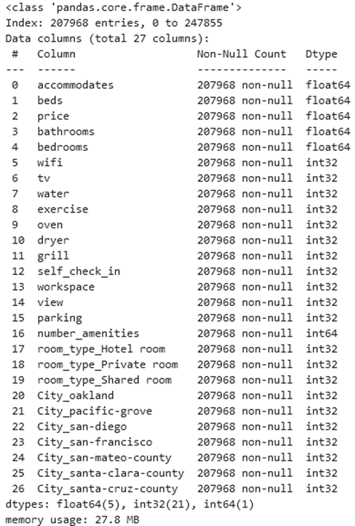
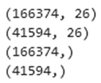
Prepared Data Frame
Post-split

Slide 7
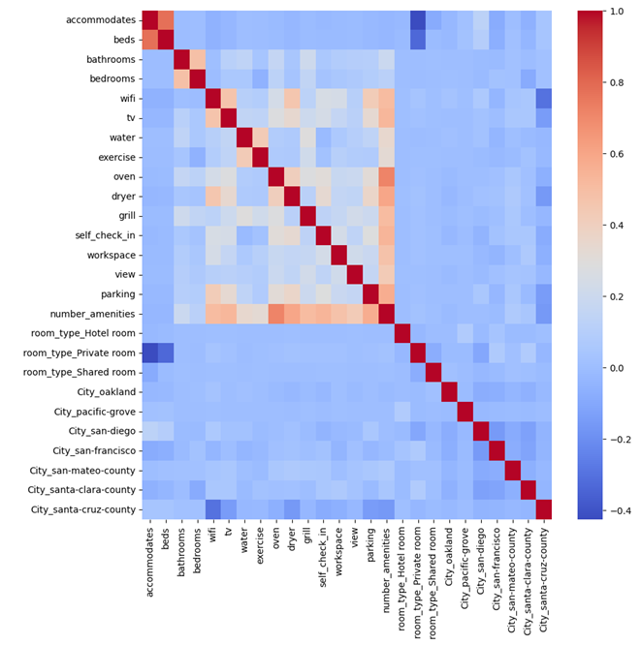
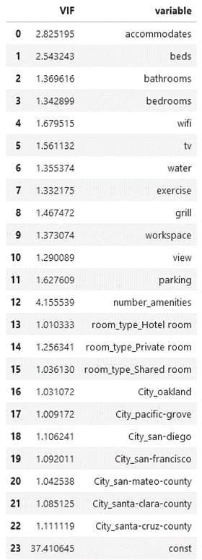
Correlation

Slide 8
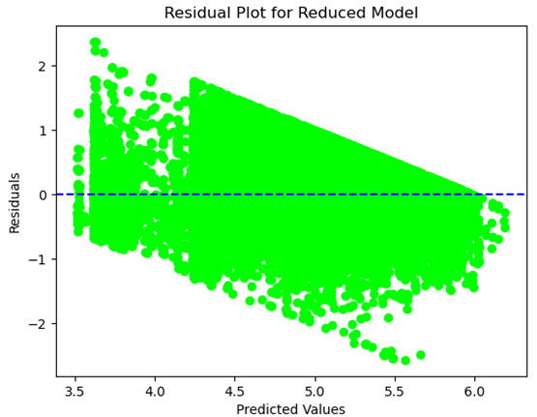
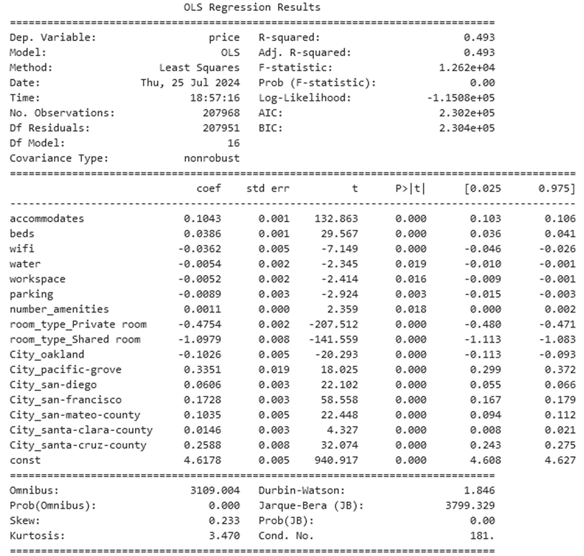
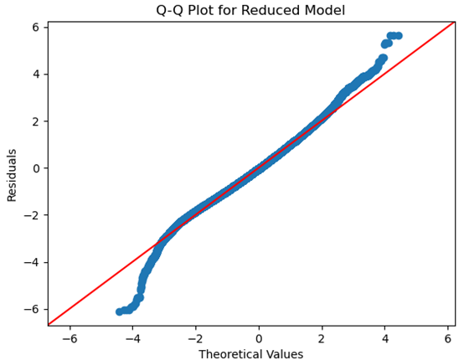
Stepwise OLS Linear Regression

Slide 9

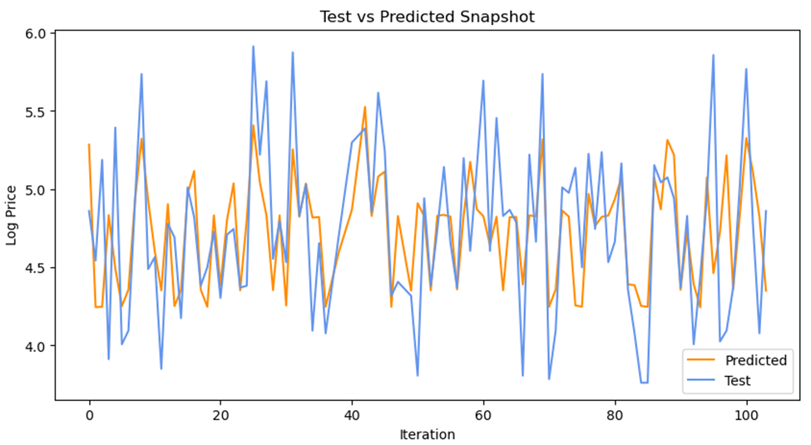
Stepwise OLS Values

Slide 10
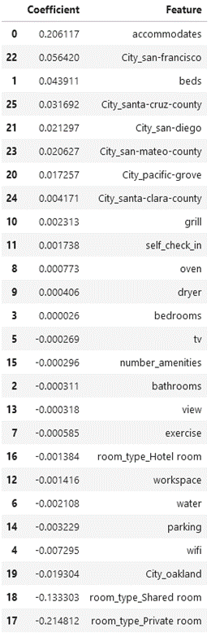
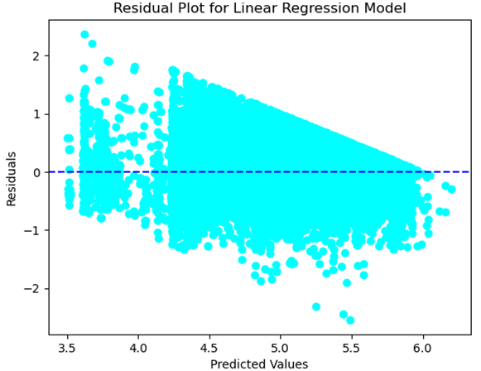
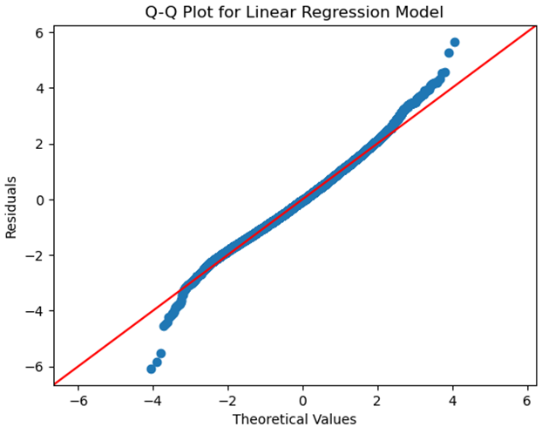
LinearRegression()

Slide 11
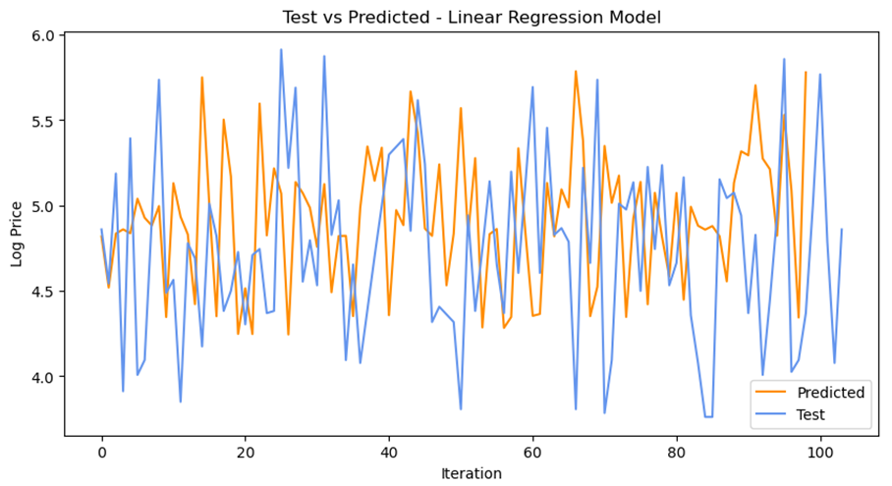
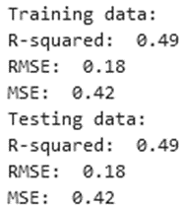
LinearRegression() Values

Slide 12
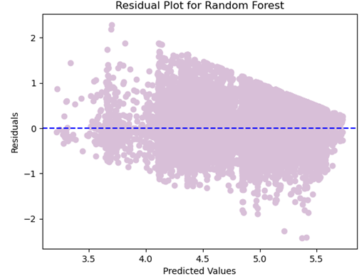
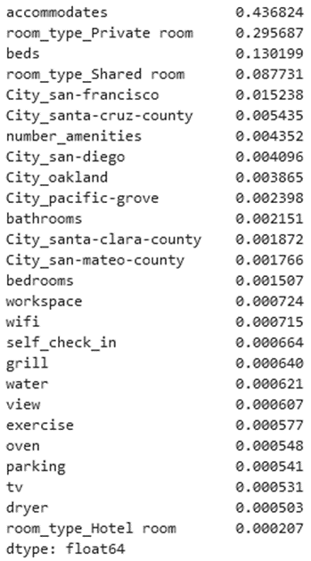
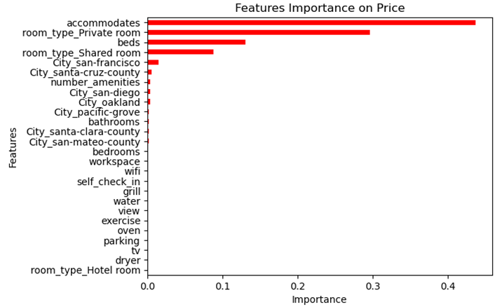
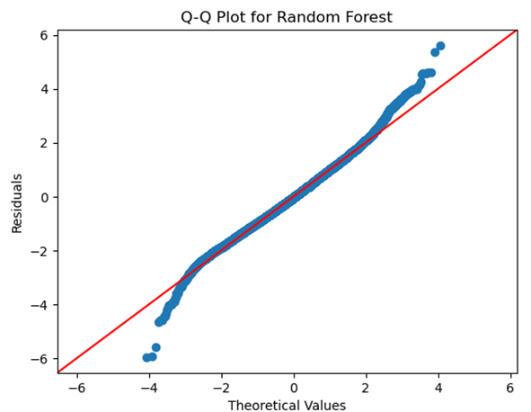
Random Forest Regression

Slide 13
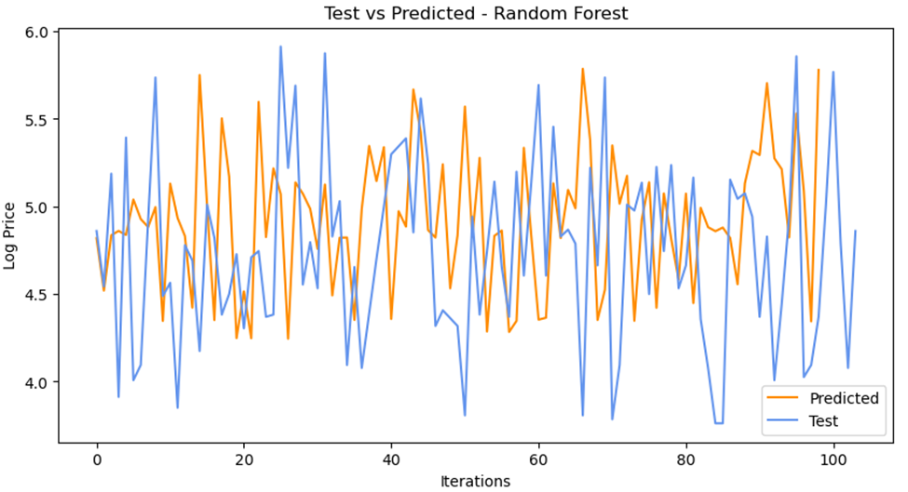
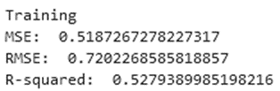

Random Forest Regression Values

Slide 14
Comparison of Models
 | Stepwise | LinearRegression | Random Forest
RMSE | 0.42 | 0.42 | 0.41
MSE | 0.18 | 0.18 | 0.17
R-squared | 0.49 | 0.49 | 0.52
Mean Score | 0.0 | 0.0018 | 0.0023

Slide 15
Findings
Null hypothesis was accepted. Not all independent variables had a statistically significant relationship with ‘price.’
Random forest regression had the best RMSE, MSE, and R-squared values proving a superior model
None of the models are accurate enough to recommend for price prediction
Variables like ‘accommodates’ correlated highly and positively across all regressions whereas ‘room_type_shared room’ was negatively correlated similarly

Slide 16
Limitations
- Complications with the original data set regarding columns like ‘amenities’ which is essentially just a list of words without homogeneity
- Linear regression has assumptions that required to prevent issues. Some of these include having a linear relationship with the dependent and independent variables, lack of autocorrection, lack of multicollinearity, and outliers.

Slide 17
Proposed Actions
- Since null hypothesis was accepted, all of the independent variables were not all statistically significant. Some, however, were shown to be.
- The models were not accurate enough to recommend
- Therefore, more data points should be collected, additional variables should be included in the compilation, and then the tests should be performed once again
Other studies have shown the alternative hypothesis to be able to be accepted in other locations with Airbnb data sets (Wang, 2023)

Slide 18
Benefits
- Predicting price prior to entering a property rental market
- For instance, a property being underpriced by $20 for 20 days a month would be a loss of $4,800 in potential revenue for the year
- Greater insight into how much certain variables affect price in order to maximize profits
- Based on this study, the number of people a property can accommodate is by far the most positively correlated variable with price while having a shared room is the most negatively correlated
Therefore, when designing a property, these could be focused upon

Slide 19
Sources
Anon. (n.d.). Is Predictive Modelling easier with R or with Python? (n.d.). ProjectPro. https://www.projectpro.io/article/is-predictive-modelling-easier-with-r-or-with-python/245
Beheshti, N. (2022, March 2). Random Forest Regression. Medium. https://towardsdatascience.com/random-forest-regression-5f605132d19d
Codify. (2024). AirBnB Listings in California. Kaggle.com. https://www.kaggle.com/datasets/setseries/airbnb-listings-in-california
GeeksforGeeks. (2017, March 19). Linear Regression (Python Implementation) - GeeksforGeeks. GeeksforGeeks. https://www.geeksforgeeks.org/linear-regression-python-implementation/
GeeksforGeeks. (2022). Stepwise Regression in Python. (2022, December 28). GeeksforGeeks. https://www.geeksforgeeks.org/stepwise-regression-in-python/
GeeksforGeeks. (2023). SAS vs R vs Python. (2023, June 12). GeeksforGeeks. https://www.geeksforgeeks.org/sas-vs-r-vs-python/
GeeksForGeeks. (2024, February 15). What are the Advantages and Disadvantages of Random Forest? GeeksforGeeks. https://www.geeksforgeeks.org/what-are-the-advantages-and-disadvantages-of-random-forest/

Slide 20
Sources (continued)
Get the Data. (n.d.). Insideairbnb.com. https://insideairbnb.com/get-the-data/
Humaizi, A. (2024, January 4). 10.0 Shapiro-Wilk test - Ahmad Humaizi - Medium. Medium; Medium. https://medium.com/@maizi5469/10-0-shapiro-wilk-test-5be38fd3c2a6
kfollis. (2023, October 31). Specify a Column to Use as Regressor in a Model. Learn.microsoft.com. https://learn.microsoft.com/en-us/analysis-services/data-mining/specify-a-column-to-use-as-regressor-in-a-model?view=asallproducts-allversions
Numeracy. (n.d.). Numeracy, Maths and Statistics - Academic Skills Kit. (n.d.). Www.ncl.ac.uk. https://www.ncl.ac.uk/webtemplate/ask-assets/external/maths-resources/statistics/regression-and-correlation/assumptions-of-regression-analysis.html
Qualtrics. (2017). Interpreting Residual Plots to Improve Your Regression - Qualtrics Support. (2017, July 19). Qualtrics Support. https://www.qualtrics.com/support/stats-iq/analyses/regression-guides/interpreting-residual-plots-improve-regression/
Tersakyan, A. (2019, October 18). Airbnb Price Prediction Using Linear Regression (Scikit-Learn and StatsModels). Medium. https://towardsdatascience.com/airbnb-price-prediction-using-linear-regression-scikit-learn-and-statsmodels-6e1fc2bd51a6
Wang, Haoqian. (2023). Predicting Airbnb Listing Price with Different models. Highlights in Science, Engineering and Technology. 47. 79-86. 10.54097/hset.v47i.8169.

